Slide 1
How to make (and pass) a test
JONATHAN HABER

Slide 2

Jonathan Haber
  Founder and CEO of SkillCheck, Inc. and creator of the Internet and Computing Core Certification (IC³)
  Co-author of National Educational Technology Standards (NETS*S): Resources for Assessment published by the International Society for Technology in Education (ISTE
  Curriculum Developer and Author – Critical Voter
  Curriculum Developer, Woodrow Wilson Academy at MIT
  Inaugural HarvardX Visiting Fellow
  Chief Learner – Degree of Freedom One Year BA Project
  Author of MOOCS: The Essential Guide (MIT Press) and Critical Voter

Slide 3
What is a test?

Slide 4
What is a test?
Any type of instrument that allows someone to demonstrate knowledge, skills, abilities, attitudes and aptitudes in a way that can be measured.
An “Active Learning Component” of an educational process.

Slide 5
STAKES
  Low stakes – No external outcomes (SAT practice, pre-training assessment, anonymous surveys)
  High stakes exams – Standardized and validated, and usually lead to important external outcomes
    Standardized educational exams (SAT, ACT, GRE)
    Professional licensure exams (NCLEX, AICPA)
    Certification exam (A+, MCSE, MOS, IC³)

Slide 6
STAKES
  Low stakes – No external outcomes (SAT practice, pre-training assessment, anonymous surveys)
  Medium stakes – Not necessarily standardized, limited external outcome (usually not legal or financial)
  High stakes exams – Standardized leading to important external outcomes
    Standardized educational exams (SAT, ACT, GRE)
    Professional licensure exams (NCLEX, AICPA)
    Certification exam (A+, MCSE, MOS, IC³)
Academic Assessment

Slide 7
Test Development processes
  Low and (usually) Medium Stakes
      Single authority (teacher)
      WALOQ (Write a Lot of Questions)
  High Stakes - Professional Exam Development Process
      Step 1: Goal Setting
      Step 2: Planning
      Step 3: Content Development
      Step 4: Analysis

Slide 8
Step 1 – Goal setting (Categories)
  Mastery
    Separate masters from non-masters (pass/fail – certification and licensure exams)
    Spread people across a continuum (SAT, A-F grading system)
  Engagement
    Are they involved with the material?
    Have they grasped concepts to which they were exposed?
  Preparation – Providing students the practice needed to achieve mastery (formative vs. summative assessment)

Slide 9
Step 2 – planning
  Examination Blueprint
    All content broken into discreet objectives (learning outcomes)
    Organized into an outline or similar structure
    Similar to a curriculum, but with a focus on measureable objectives
  Test Design Document – Contains all non-content specifications for a test
    Test length
    Item style (linear, performance-based, rubric-scored, etc.)
    Grading system
    Method of delivery (written, online, proctored vs. non-proctored), etc.

Slide 10
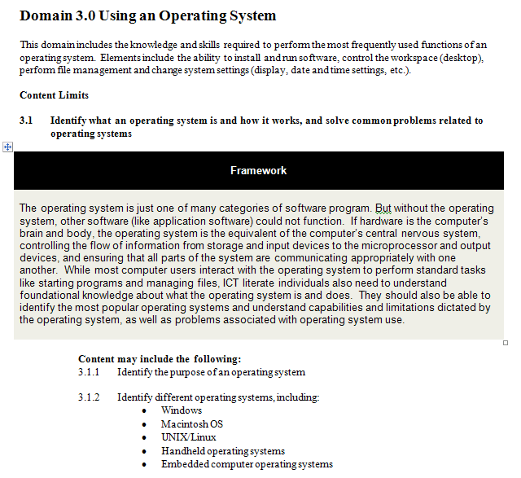
Exam Blueprint

Slide 11
Test Planning – Non-Content Specs
  Length of test (45 minutes)
  Type of questions to be used (linear and performance-based - interactive simulation)
  Delivery system (Internet)
  Grading mechanism (pass/fail)
  Remediation (none)
  All other non-content specifications

Slide 12
Step 3 – content development
  Linear Assessment
    Multiple choice
    Multiple response (multiple-answer)
    Short answer/fill-in-the-blank
    Matching
  Performance Based Assessment
    Interactive simulation
    Artifact-creation (written essays, lab reports, programming tasks)
    Contribution (discussion, group projects, etc.)
    Observation

Slide 13
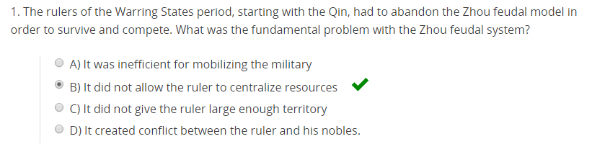
Anatomy of a Linear Test Item
Stem
Distractors
Answer
Responses

Slide 14
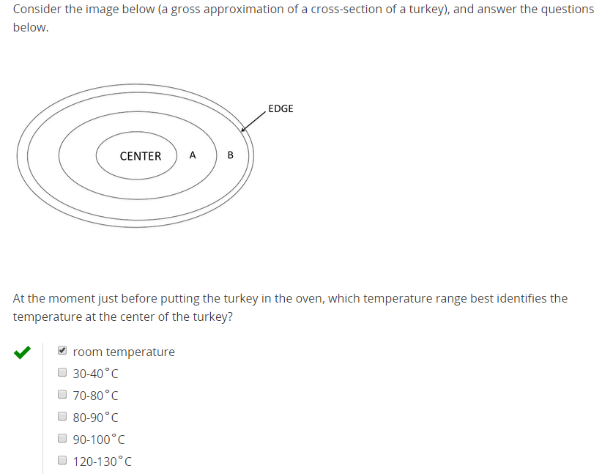
Exhibits

Slide 15
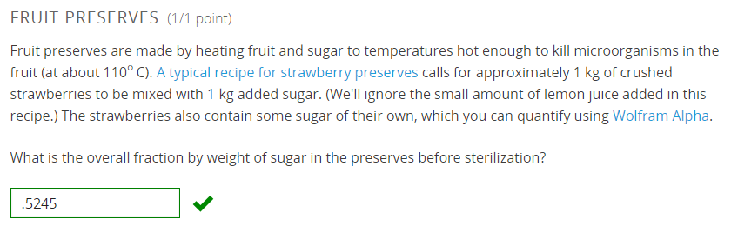
Open ended items

Slide 16
Rules for Writing Test Items
Each item should measure a single, clearly defined objective
Items should be written in language that is at or below the average reading level of the students targeted by the assessment
Items should be clearly written, unambiguous and free of cultural bias
Responses should be of equivalent length and arranged in a logical order (by length, alphabetically, etc.)
Avoid true/false items or multiple choice items with responses such as “All of the Above,” “None of the Above,” “A and C,” etc.
Distractors should all be plausible and of equivalent plausibility
Avoid trick questions
Multiple response items should indicate the number of answers in the stem
Exhibits should relate directly to the test question and not provide distracting or extraneous information
Avoid items that may disclose answers to other items in the same test

Slide 17
Linear items - Common Problems
A binary number consists of what digits?
A. 3
B. 1
C. 2
D. 0
E. 4
Select the two digits that make up a binary number.
A. 0
B. 1
C. 2
D. 3
E. 4

Slide 18
Linear items - Common Problems
APPLE:: RED as LEMON::
A. Yellow
B. Green
C. Blue
D. Orange
STOP::RED as GO::
A. Blue
B. Green
C. Orange
D. Yellow

Slide 19
Linear items - Common Problems
A sonnet is an example of _______.
A. a poem
B. a painting
C. a form of music
D. an airplane
A sonnet is an example of a/an _______.
A. story
B. poem
C. opera
D. painting

Slide 20
Common errors in item writing
  Use or overuse of True-False, “All of the Above,” “None of the above” or equivalent (A & C, etc.)
  Longest response is too often correct
  Second longest response is too often correct
  Option C is too often correct
  Correct answer is too obvious
  Distractors are obviously wrong (not plausible, jokes, etc.)
  Test items have been used too many times previously (“over-exposed”)
  Question is confusing (often covering too many learning objectives)
  One or more distractors (wrong answers) are correct

Slide 21
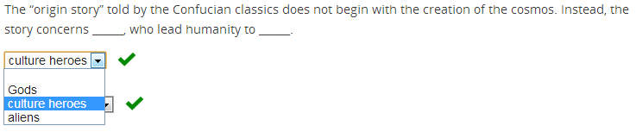
PROBLEM ITEM #1
Learning objective: Identify that the original story told by Confucian classics begins with cultural heroes leading humanity towards civilization.
Gods
Demi-Gods
Culture Heroes
Military Heroes

Slide 22
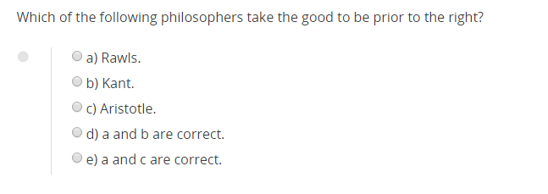
PROBLEM ITEM #2 – Before

Slide 23
PROBLEM ITEM #2 – After
In the debate over abortion, which of the following arguments represents the right preceding the good?
The scientific argument over what constitutes life and when life begins
The Catholic Church’s argument that abortion is morally wrong in all circumstances
The political argument that, in a democracy, abortion should be a matter of individual choice
The Pro-Choice argument that a woman has absolute autonomy over what happens to her own body

Slide 24
Performance-based assessment
  Types of performance-based assessments:
    Writing assignments
    Individual or group projects
    Presentations
    Observable activities
  These need to generate
    A gradable artifact
    Observable behavior
  Quality performance assessments should be built around:
    Well-constructed rubrics
    Assignment instructions that will lead to evidence that can be rubric scored

Slide 25
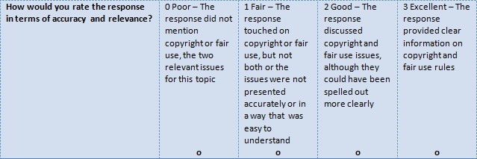
Parts of a rubric
Performance Levels
Criterion
Descriptors

Slide 26
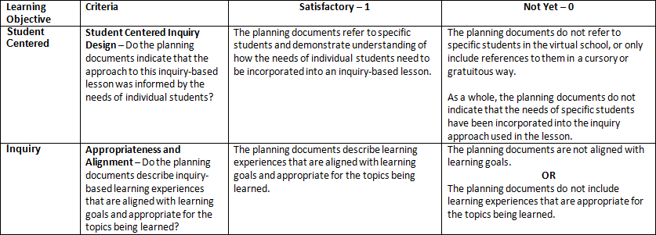
Rubric-scored assignment

Slide 27
Creating quality pb assessments
  Creating assignments that lend themselves to rubric scoring
    Enough criteria
    Appropriate balance between criteria
    Meaningful performance levels
    Not contrived to meet the requirements of rubric scoring
  Writing clear descriptors to allow a grader to accurately assign someone to a performance level
  Instructing students regarding what is expected of them
  Maximizing inter-rater reliability
    Training of graders
    Providing exemplars

Slide 28
Step 4 – Analysis (validation)
  Types of test validity
    Content validity
    Construct validity
    Criterion validity

Slide 29
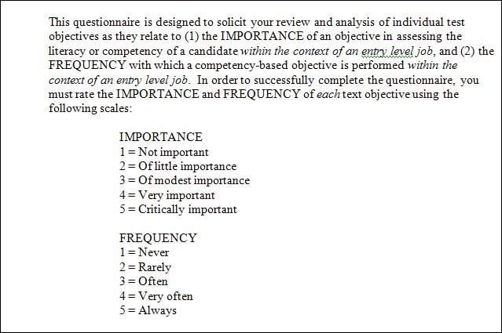
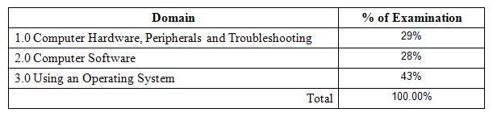
Content balance

Slide 30
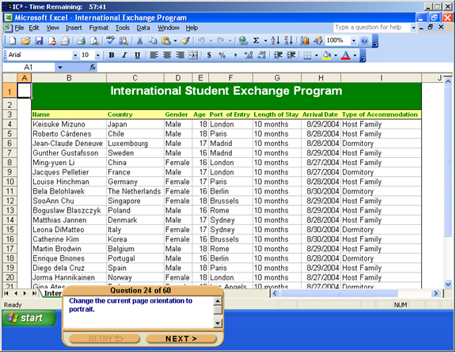
Examples of constructs
The option to change page orientation can be found in the _______ menu.
File
Edit
View
Format

Slide 31
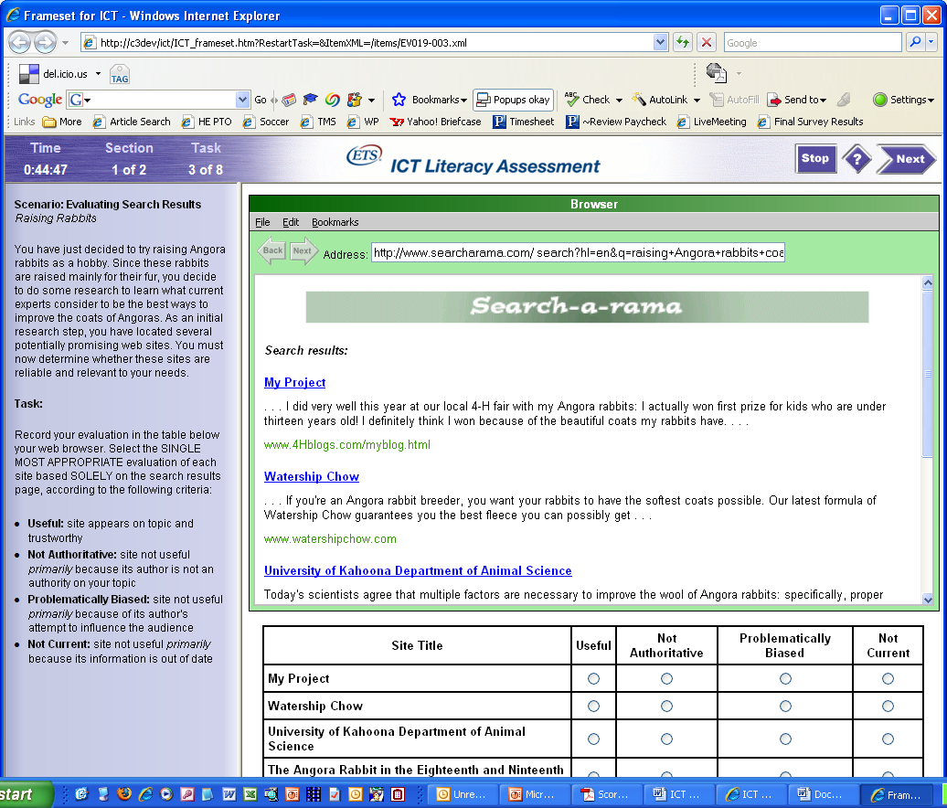
Examples of constructs

Slide 32
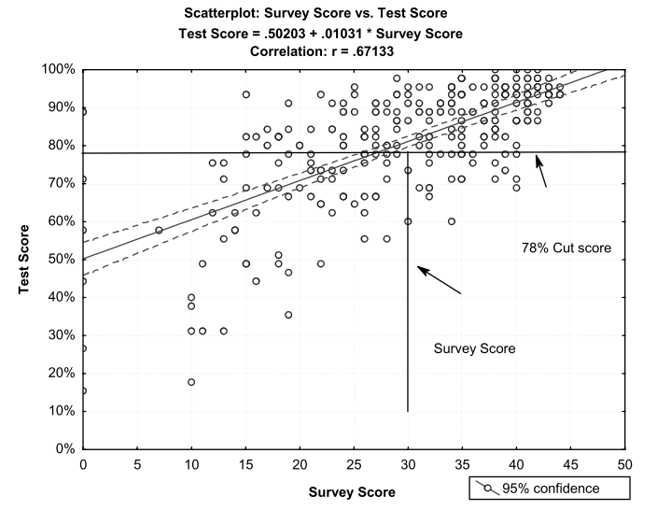
Criterion analysis

Slide 33
Test analysis
  Beta Process
    Create test forms with the same content balance
    Test a statistically significant sample of people of known ability (high, medium and low performers)
  Post-beta analysis
    Item analysis – How did items perform
      Distractor analysis – Check potential problem items
    Creation of parallel test forms
    Test calibration and cut-score determination
  Final exam construction and release

Slide 34
Item Analysis
ITEM | p-VALUE (difficulty) | r-Value (consistency)
1 | .93 | .22
2 | .94 | .55
3 | .50 | .56
4 | .20 | .48
5 | .25 | .14

Slide 35
Distractor Analysis
An operating system is the equivalent of the body’s _______.
p=.35
r=.20
An operating system is the equivalent of the body’s _______.
Eyes (15%)
Body (15%)
Brain (35%)
Nervous system (35%)

Slide 36
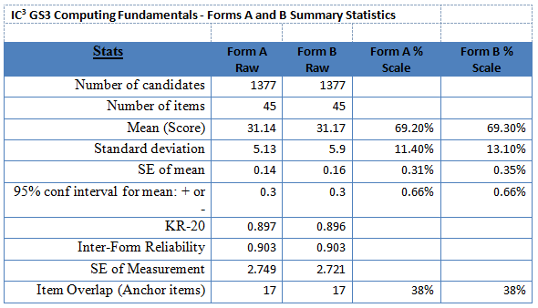
Creation of parallel forms

Slide 37
Cut-score determination

Slide 38
Q&A

